Slide 1

SkillSwApp
Designosaurus Rex Proudly Presents…
Brought to you by
Kailan Bates - 460422
Kajal - 461853
Deepanshi - 456807
Lovekesh Singh Parihar - 457722
Felipe Alves Barbosa - 446597
**Disclaimer: Use of the SkillSwap app does not guarantee an improvement to skills. ***SkillSwapp is not responsible for ANY injuries sustained while learning new skills.

Slide 2
Design Summary
Our design is for Skillswap, a platform for exchanging skills and knowledge in the community and education industries.
This platform is perfect for adult users located in Calgary, between the ages of 18-44 for all genders.
SkillSwap is aimed at user-to-user exchange of skills and services in person or on video calls.
Skillswap is designed with an intuitive and personalized interface that improves matching, communication, and session management.

Slide 3
Market Research
Conducted Surveys:
Features Identifying Survey
Design Protype Survey
Key Findings:
Positive feedback on the app's layout
Minor adjustments to color palette and button spacing
Key Concerns:
Quality and reliability of skills
Certifications for completed workshops
Core functionality will remain free with optional premium perks

Slide 4
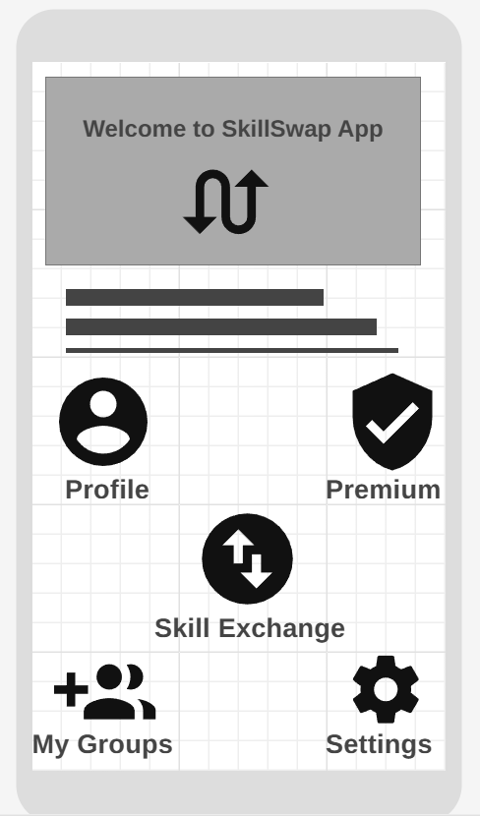
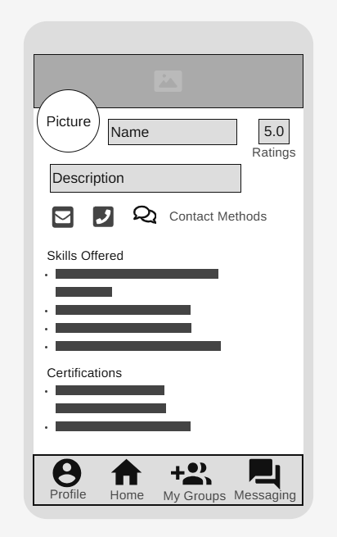
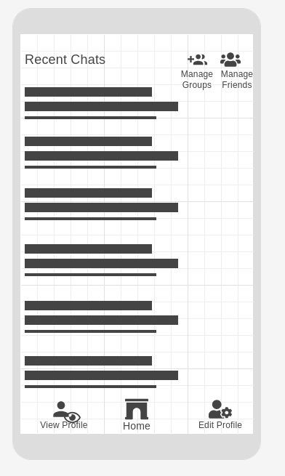
Genuine Original Wireframes
Home page
View Profile
Messaging

Slide 5
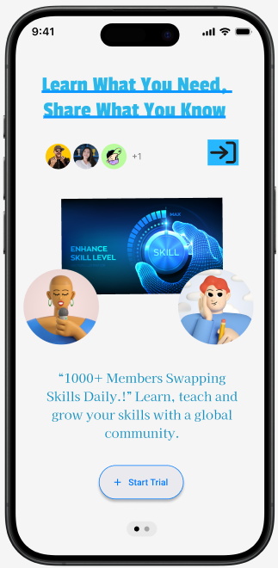
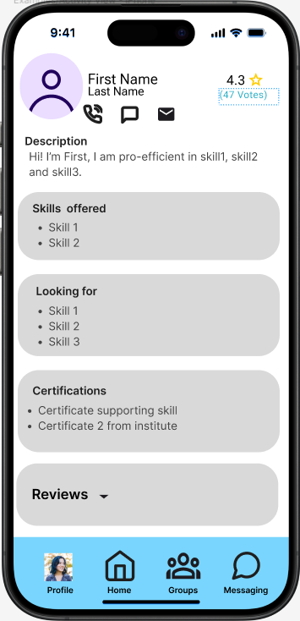
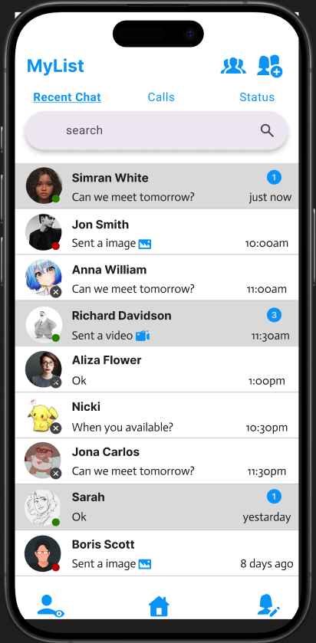
Draft Prototypes
Home Page
View Profile
Messaging

Slide 6
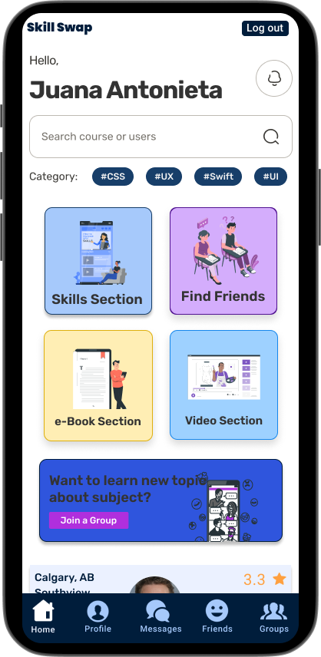
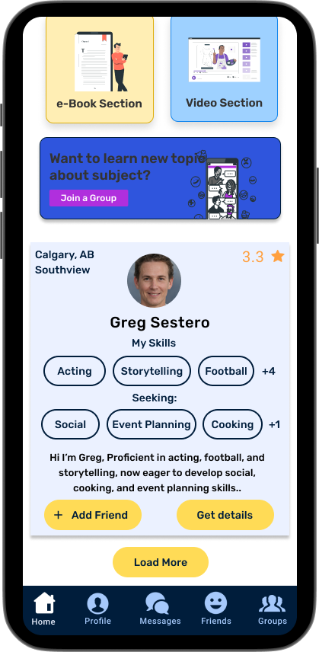
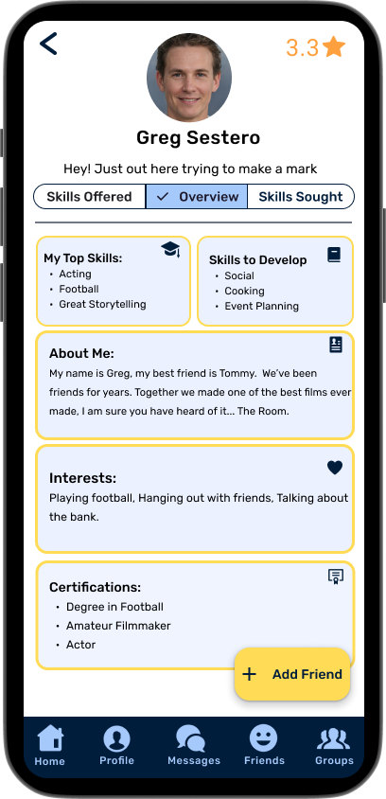
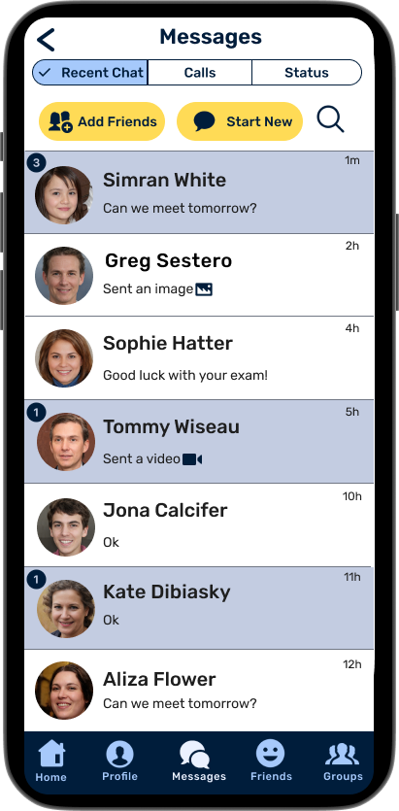
Final Designs

Slide 7

SkillSwap's future
Phase One:
Phase Two:
Phase Three:

Slide 8
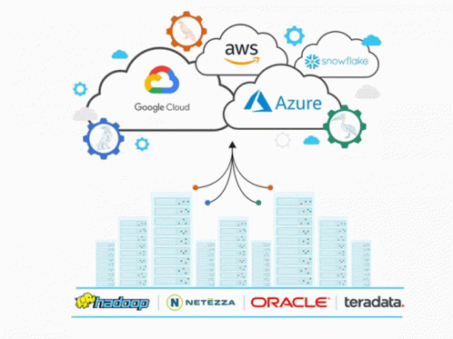

Phase One
(Dribbble, 2024)
Marketing, including creating a blog, detailing app development, success stories and industry trends to garner interest SkillSwap
Use the funding for an app programming and server infrastructure, which can enhance the scalability and reliability of an app.
(Vyxsynn, 2024)

Slide 9


Phase Two
(Canva, 2024)
(Canva, 2024)
Canva
Introduce live app study group to acquire feedback from using the app.
Video and Interactive Tutorials

Slide 10


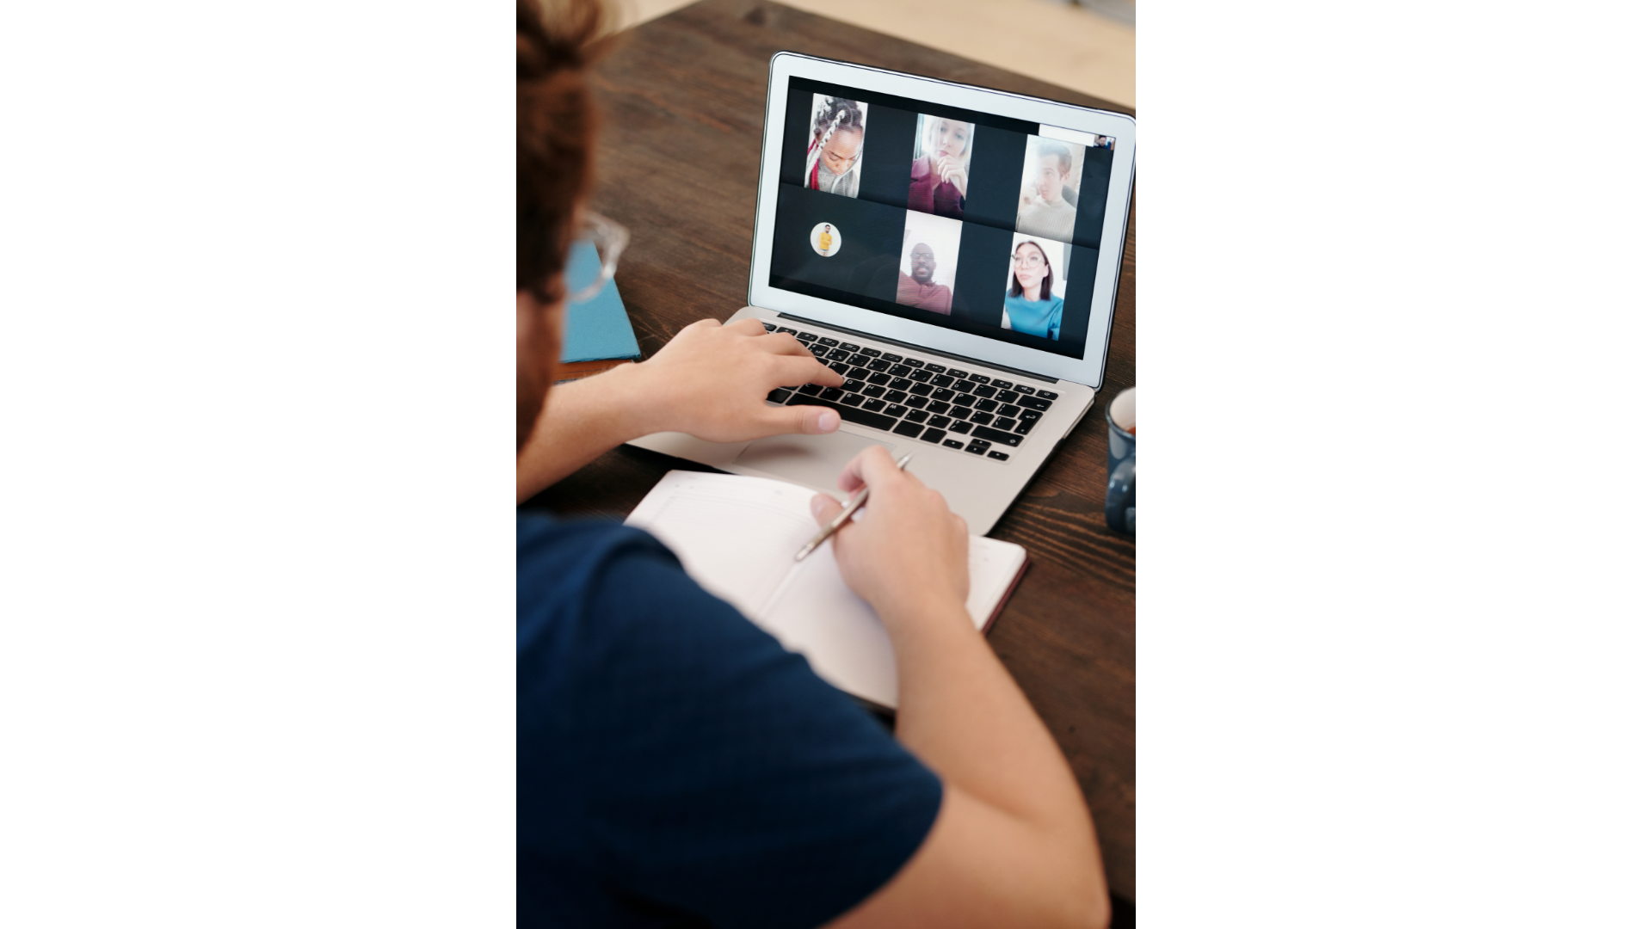
Phase Three
(Canva, 2024)
Integrate features such as video tutorials, live sessions, premium, etc.
Built-in scheduling tools to help users find mutually convenient times for skill swaps(check this one)

Slide 11
References
All references:
Tenor. (n.d.). SpongeBob rainbow yes imagination [GIF]. Tenor. https://tenor.com/en-CA/view/spongebob-rainbow-yes-imagination-gif-14776727382727473857
Dribbble. (n.d.). Adf5b14ee2e6d0e8d75271e16299b8c8 [GIF]. Dribbble. https://cdn.dribbble.com/users/1912990/screenshots/6129020/media/adf5b14ee2e6d0e8d75271e16299b8c8.gif
Canva. (n.d.). Programmers engrossed in deep collaboration, diligently working together to solve complex problems and develop innovative mobile applications with seamless functionality [Photo]. Canva. https://www.canva.com/photos/MAFmHXNuj-A-programmers-engrossed-in-deep-collaboration-diligently-working-together-to-solve-complex-problems-and-develop-innovative-mobile-applications-with-seamless-functionality-/
Canva. (n.d.). A man holding a pencil and conducting an online tutorial [Photo]. Canva. https://www.canva.com/photos/MAEdH1rCU9g-a-man-holding-a-pencil-and-a-music-conducting-an-online-tutorial/
Canva. (n.d.). Close-up of wall calendar [Photo]. Canva. https://www.canva.com/photos/MADQ46cMfeM-close-up-of-wall-callendar/
Canva. (n.d.). Rolled white paper and a certificate on a pink surface [Photo]. Canva. https://www.canva.com/photos/MAEgPrsuGto-rolled-white-paper-and-a-certificate-on-a-pink-surface/
Canva. (n.d.). Man in blue shirt having a virtual meeting [Photo]. Canva. https://www.canva.com/photos/MAEP63XIHms-man-in-blue-shirt-having-a-virtual-meeting/
Profile Pictures. Random people generator [Photo]. Thispersondoesntexist. https://thispersondoesnotexist.com/

Slide 12
References
Regarding social media use and perceived isolation.
Kassandra I Alcaraz, Katherine S Eddens, Jennifer L Blase, W Ryan Diver, Alpa V Patel, Lauren R Teras, Victoria L Stevens, Eric J Jacobs, Susan M Gapstur, (2019, January 1). Social isolation and mortality in US black and white men and women. American journal of epidemiology, volume 188, issue 1. https://academic.oup.com/aje/article/188/1/102/5133254
Regarding social isolation, mortality and wellbeing
Brian A. Primack MD, PhD, Ariel Shensa MA, Jaime E. Sidani PhD, MPH, Erin O. Whaite BS, Liu yi Lin MD, Daniel Rosen PhD, Jason B. Colditz MEd, Ana Radovic MD, MSc, Elizabeth Miller MD, PhD (2017, July). Social media use and perceived social isolation among young adults in the U.S. Science Direct. https://www.sciencedirect.com/science/article/abs/pii/S0749379717300168
Meetup Measurement Report, (2023). State of friendships: the 2023 meetup measurement report. chrome-extension://efaidnbmnnnibpcajpcglclefindmkaj/https://www.meetup.com/marketing-assets/PDF/Meetup+Trend+Report+v13.pdf
Similarweb, (2024). Skillshare.com website traffic demographics. https://www.similarweb.com/website/skillshare.com/#geography
Statistics Canada, (2024). Table 45-10-0104-01 daily average time spent on various activities, by age group and gender, 2022. https://www150.statcan.gc.ca/t1/tbl1/en/cv.action?pid=4510010401

